Slide 1
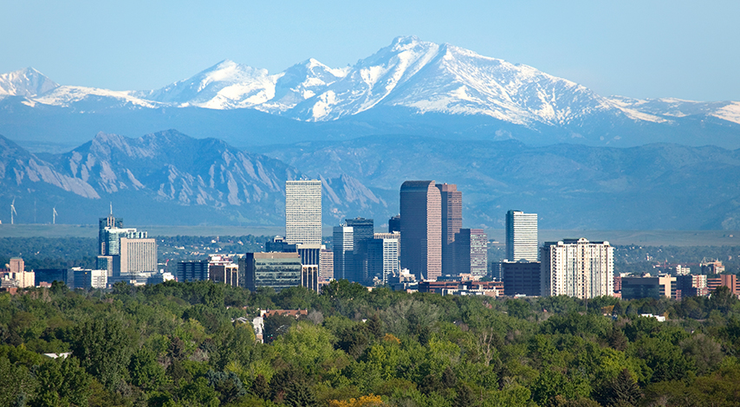
Denver’s Neighborhood Watch
PR1-ABRSY Consulting
Notes:
Good evening. My name is Yua and I’m with PR1- ABRYS Consulting. Thank you for joining us this evening to hear the results of our analysis to provide Caruso Partners with the results of Denver’s safest neighborhood’s.
Before we get into the results I’d like to introduce members of our project team as they will be available to answer any questions.
Reda- Project Manager and Lead Strategist
Ben, Alex, and Scott as Data Scientists

Slide 2
Business Engagement
Notes:
Our firm typically provides crime data analysis to law enforcement and city governments for neighborhood development and community engagement. We had a recent request from Caruso Partners to leverage our resources to provide recommendations for crime awareness in Denver to increase overall safety of the city, trends and activity. Caruso Partners shared with us that although there is a wide resource recommending the best places to live base on lifestyle and income and things to do, there weren’t many options for the risk adverse when safety is their #1 priority, unless you are one of the cool data scientist students at DU’s data boot camp. Obviously, no neighborhood is crime proof, but our client asked is to provide a three year look back to 2015 to identify the following:
What type of crimes are occurring in Denver?
Are certain areas more crime ridden?
How does time of day affect the likelihood of a crime occurring?
What are the top five crimes?
We wanted to ensure that our analysis was comprehensive and ensured that was inclusive of occurrence attributes such as time, date, neighborhoods, but that the report was meaningful and captured the actual crime categories. Based on our deliverables, we approached this project analyzing two data sets from the City and County of Denver: crimedata.csv and offense_code.csv. This was an iterative process as customer satisfaction is important to us and Caruso Partners was involved in each phase of the project as we uncovered the story behind the data.

Slide 3
Felonies
Misdemeanors
Class 1 felonies are the most serious crimes in Colorado, punishable by life imprisonment or the death penalty. (Colo. Rev. Stat. § 18-1.3-401.) First degree murder is an example of a class 1 felony.
Class 2 felonies in Colorado are punishable by eight to 24 years in prison and a fine of $5,000 to $1,000,000. (Colo. Rev. Stat. § 18-1.3-401.) A second conviction for selling Schedule I or II drugs is a class 2 felony.
Class 3 Felonies- A conviction for a class 3 felony can result in a state prison sentence of four to 12 years and a fine of $3,000 to $750,000. (Colo. Rev. Stat. § 18-1.3-401.) For example, patronizing a prostituted child is a class 3 felony.
Class 4 felonies are punishable by two to six years’ imprisonment and a fine of $2,000 to $500,000. (Colo. Rev. Stat. § 18-1.3-401.) Sexual assault is an example of a class 4 felony.
Class 5 Felonies Colorado’s laws impose a sentence of one to three years in prison and a fine of $1,000 to $100,000 for a class 5 felony conviction. (Colo. Rev. Stat. § 18-1.3-401.) Theft of property from a person is a class 5 felony.
Class 6 felonies are the least serious felonies in Colorado, punishable by one year to 18 months in prison and a fine of $1,000 to $100,000. (Colo. Rev. Stat. § 18-1.3-401.) Possession of up to two grams of methamphetamine is a class 6 felony.
A class 1 misdemeanor is the most serious type of misdemeanor in Colorado. Class 1 misdemeanors are punishable by six to 18 months in jail, a fine of $500 to $5,000, or both. (Colo. Rev. Stat. § 18-1.3-501.) Possession of anabolic steroids is a class 1 misdemeanor.
A class 2 misdemeanor carries a possible jail term of three to 12 months, a fine of $250 to $1,000, or both. (Colo. Rev. Stat. § 18-1.3-501.) Theft of property worth less than $500 is a class 2 misdemeanor.
Class 3 misdemeanors are the least serious misdemeanors under Colorado’s laws, punishable by up to six months in jail, a fine of $50 to $750, or both. (Colo. Rev. Stat. § 18-1.3-501.) Prostitution is a class 3 misdemeanor.
Traffic Misdemeanors- In Colorado, “traffic misdemeanors” are treated differently than other misdemeanor crimes. Traffic misdemeanors are divided into class 1 and class 2. A class 1 traffic misdemeanor carries ten days to one year in jail, $300 to $1,000 in fines, or both. Class 2 misdemeanors carry ten to 90 days in jail, $150 to $300 in fines, or both. (Colo. Rev. Stat. Ann. § 42-4-1701.) Reckless driving is a class 2 traffic misdemeanor.
Notes:
Like all states, Colorado divides crimes into felonies and misdemeanors.
Felonies are more serious crimes, punishable by state prison terms of one year or more.
Misdemeanors are less serious crimes, punishable by county or local jail terms of up to 18 months.
Public Disorder Crimes: Criminal Mischief, Prostitution and Commercialized Vice, Drunkenness, Disorderly Conduct, Vagrancy, Curfew and Loitering

Slide 4
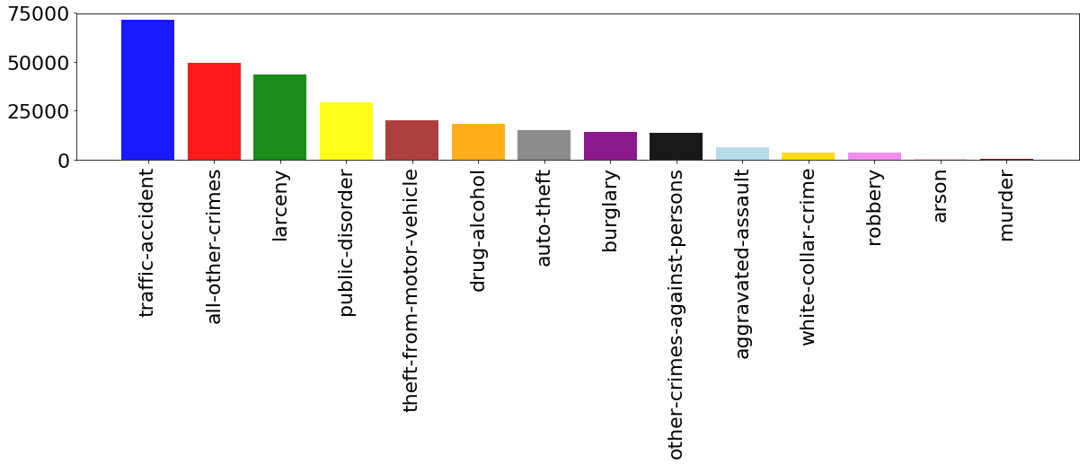
What crimes are occurring in Denver?
Notes:
Since 2015 the crimes that have occurred in Denver range from traffic violations to murder. Traffic accidents account for 25% of the crimes whereas felonies are less than 5%.

Slide 5
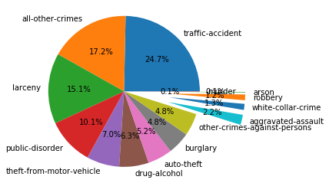

Slide 6
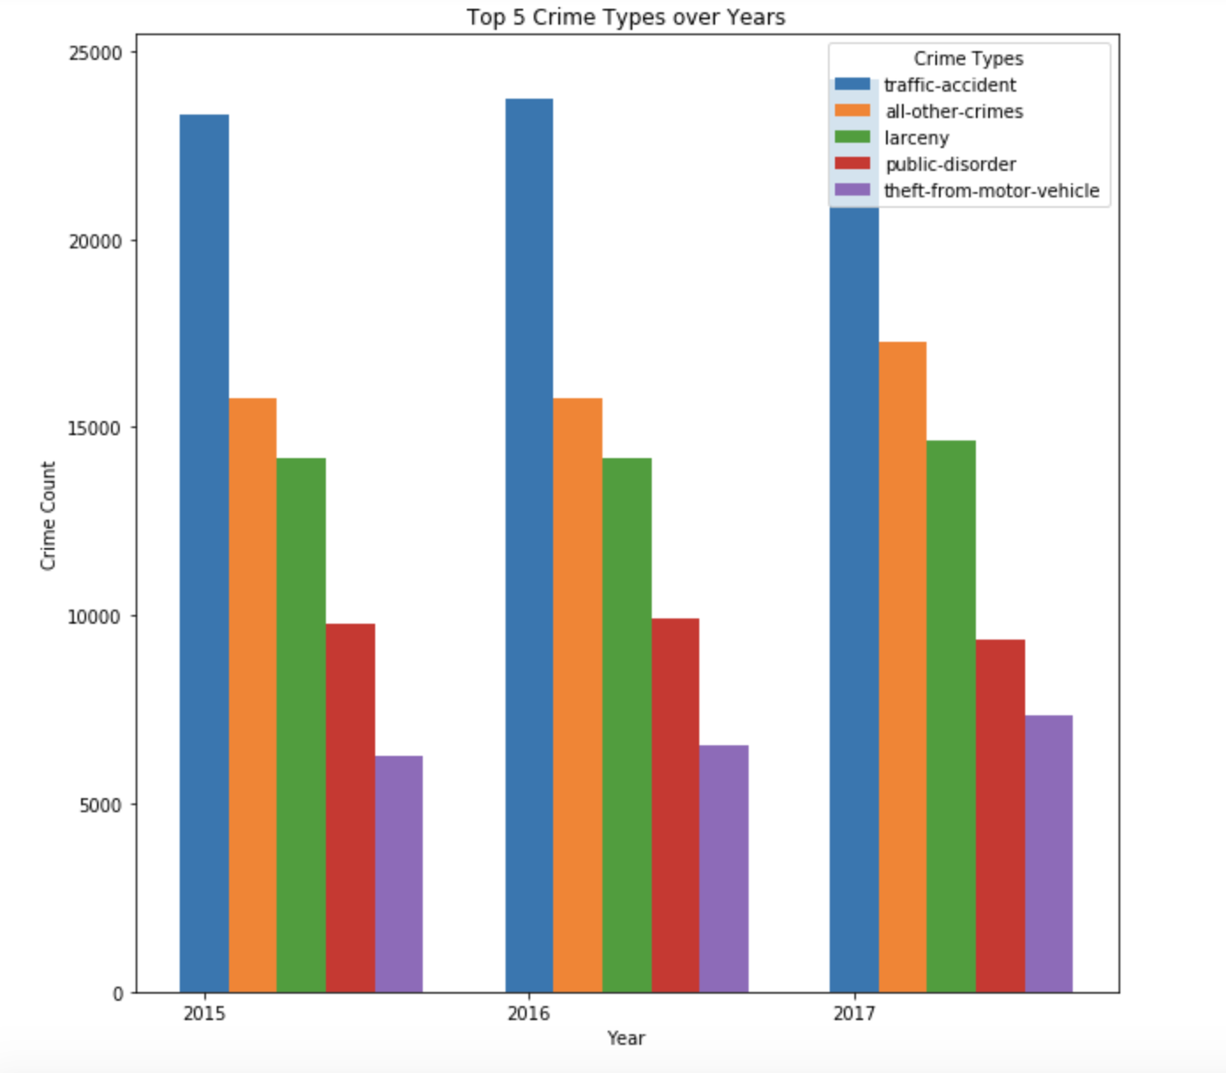
Notes:
Trends for the top five crimes have stayed consistent over the last 3 years.
Colorado petty, misdemeanor and felony theft- In Colorado, the penalty for theft depends on: 1) The value of the item taken, 2) Whether the victim is considered “at risk” (elderly or disabled), and
3) The means by which the item was stolen.
Acts prohibited by Colorado's theft law include, without limitation: Shoplifting (theft by concealment), Passing bad checks, Con games, Theft by fraud, false pretenses and deception, Theft by criminal extortion, Petty theft, and Embezzlement.

Slide 7
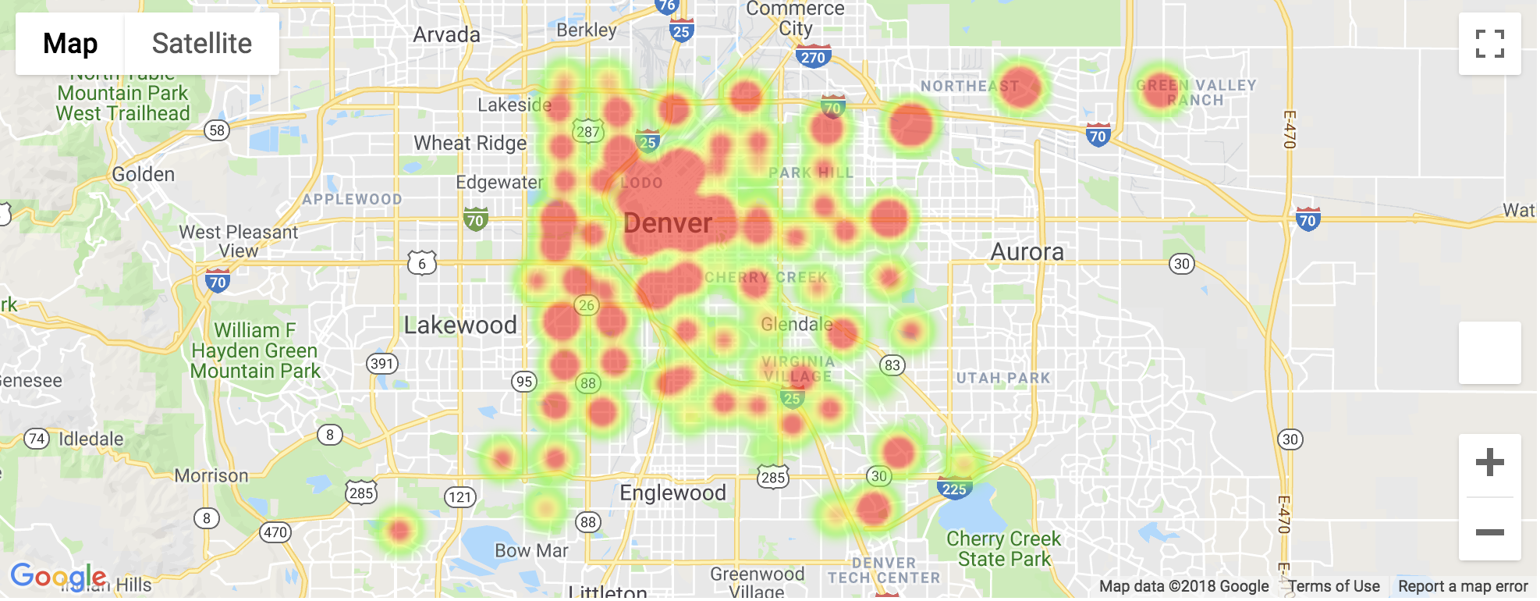
Where’s the Crime?
Notes:
Red is how much crime activity

Slide 8
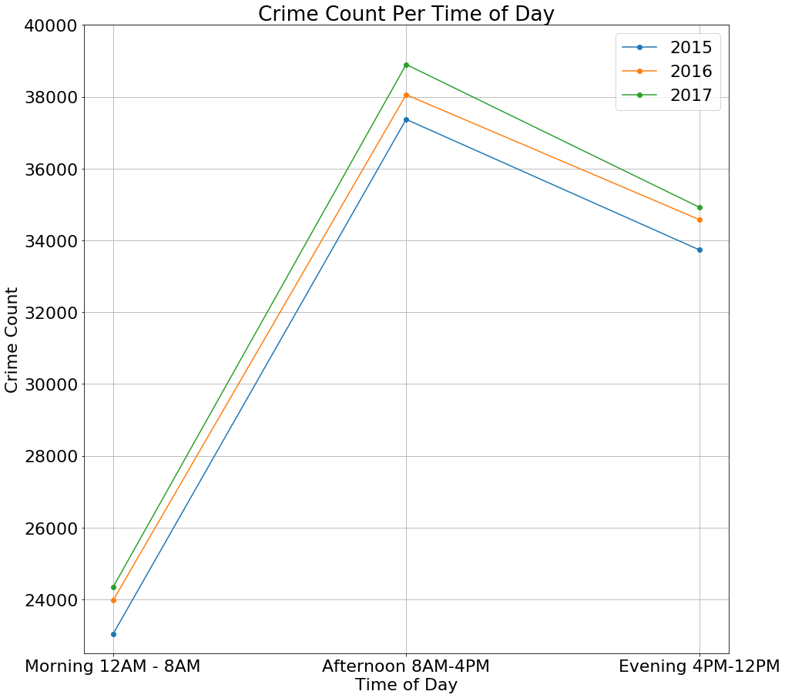
Notes:
For all points in the day crime is on rise.

Slide 9
Conclusions:
Caruso Partner’s program should focus on:
How to prevent traffic accidents and theft as they were the top occurring infractions from 2015-2017.
Crimes are more prone to occur during day time hours of 8 am– 4 pm.
Crime density is highest in the Five Points neighborhood.

